Slide 1
Empathetic DevOps
- Ike Jones

Slide 2

The Land Before Time
Waterfall Methodology
Monolith Applications
Source Control?
Peer Reviews?
Manual Deployments

Slide 3

2001: A Space Odyssey
Agile Manifesto
Deliver Early, Deliver Often
Focus on Delivering Value
Continual Improvement
Cross-Functional Teams
Improved Source Control/Versioning
Reduced Feedback Loop Between Developers and the Customer

Slide 4

Home Alone
What about IT Ops?
Notes:
Agile forgot about Operations. Software Developers were moving at a faster pace, but Ops still lagged behind.

Slide 5

Saving Private Ryan
DevOps
Improved Communication/Collaboration Between Developers and Operations
Improved CI/CD
Automated Deployments
Infrastructure as Code
Application Performance Monitoring
Product/Project Ownership
Notes:
A few years later we went back for him
This is when ops was brought in.

Slide 6

The Matrix
Processes Over 135 Million Transactions Per Year
Manages Over $1 Trillion in Retirement and Health Benefits
Disburses Over $500 Billion Per Year
~12,000+ Total Employees
~2,000 IT Employees
~120 Production Systems
Agency’s First Large Agile Project
Notes:
Talk about NFT, what we were building, the agency’s first big agile project. The manual deployments. The stress, the hours worked, the arguments,
BEGIN TALKING ABOUT HOW I DISCOVERED DEVOPS

Slide 7
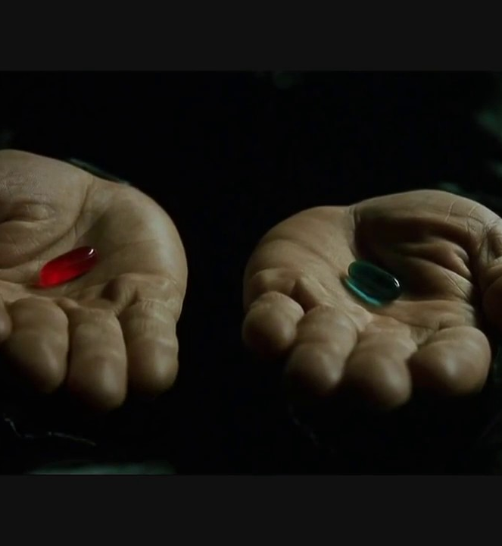
The Matrix
Stay the course?
Notes:
I took the red pill

Slide 8

National Lampoon’s Vacation
My DevOps Journey
Notes:
So begins my personal DevOps Journey

Slide 9

A Beautiful Mind
Flow Charting Processes
Creating Value Stream Maps
Analyzed Multiple Projects
Collected as Much Data as Possible
Notes:
I became a power point professional

Slide 10

Hidden Figures
Average 27 Days Between Feature Request and Development
Average 93 Days Between Development & Testing
Average 187 Days Between Development & Production
$60,000 - $110,000 Per Month in Testing
6 Months – 2yrs Between Feature Request and Development for Legacy Projects
Up to 6yrs for New Features to Reach Production
Led Roughly 2,000 Micro-Apps (Access, Excel, Word, FoxPro)
Notes:
Shadow IT, risk, compliance

Slide 11
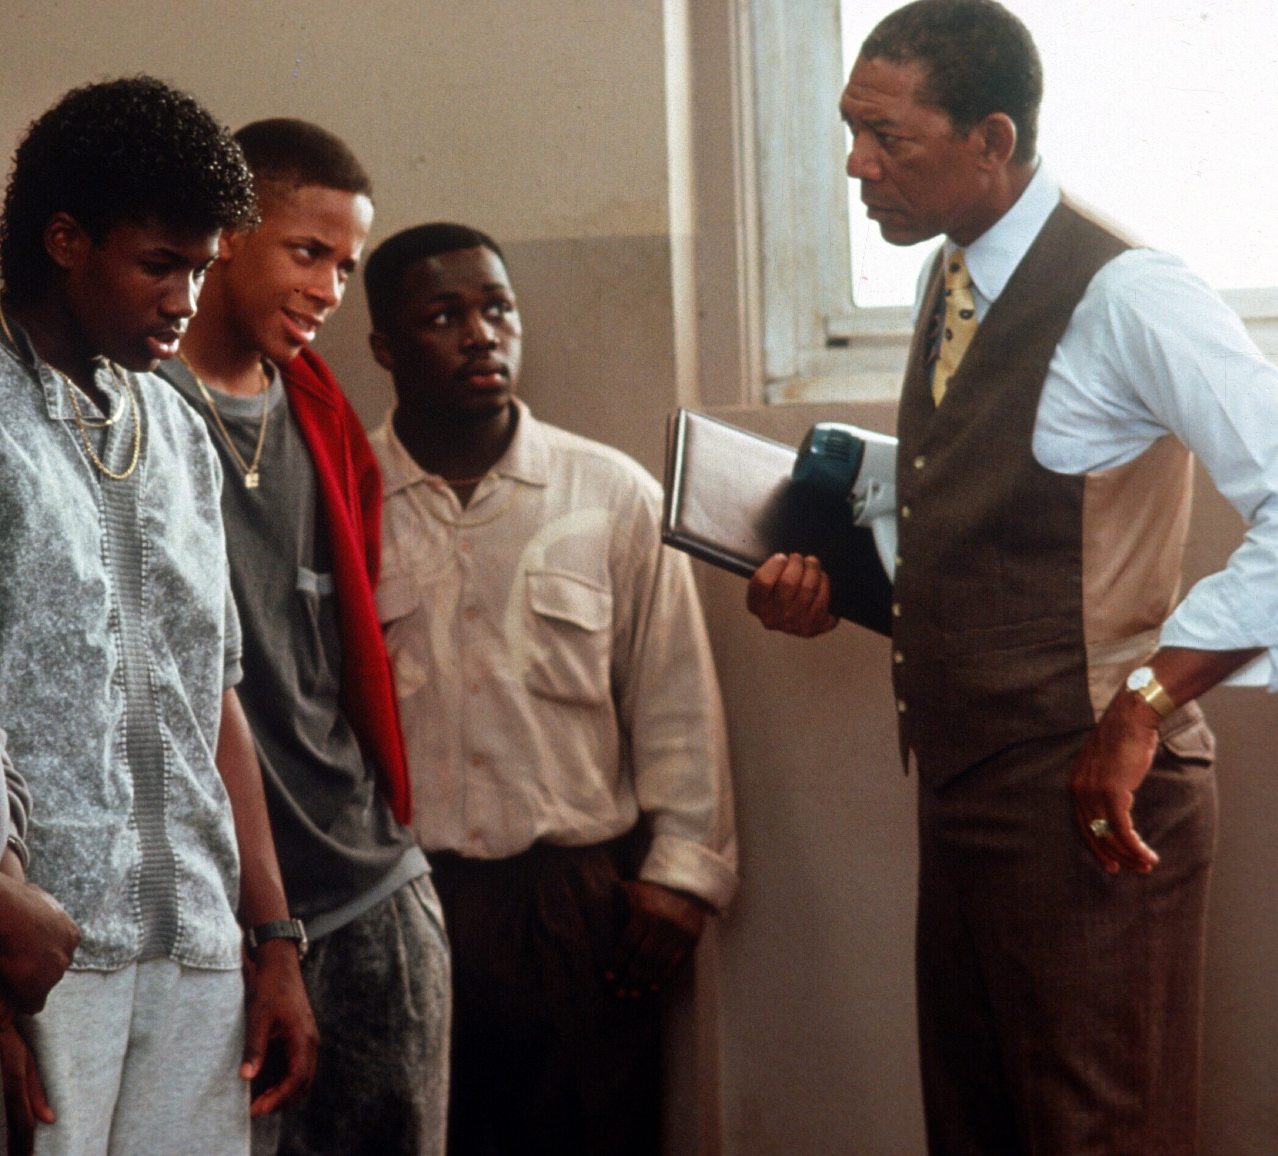
Lean On Me
Evangelizing DevOps
Explain Data
Demo New Methodology & Tools
Building a Coalition

Slide 12

The Perfect Storm
The Only Purpose of This Slide is to Lead into the Next Slide

Slide 13

The Titanic
Epic Failure
Notes:
No matter what we did, we couldn’t get more than 6ft, 1.8288 meters, off the ground.
WE could implement Git, but couldn’t implement proper CI/CD or automated deployments

Slide 14
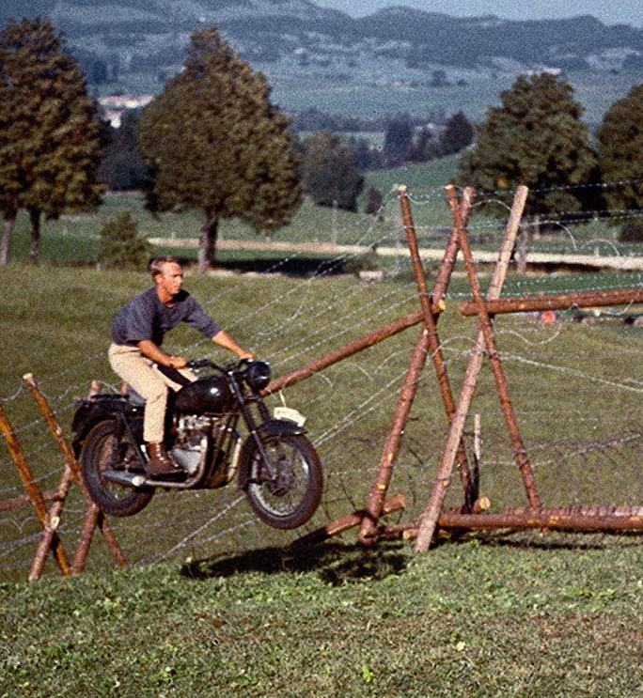
The Great Escape
I Quit
Notes:
It just ended up being too much. To keep pushing was an excersice in insanity

Slide 15

Silver Linings Playbook
Things That Help Teach Us
Shared Context
Bi-Directional Communication
Scope Management
Project-Based Development
Scaling IT Processes
Testing
Culture
Notes:
Internal Software Cannot be Project-Based. Project-Based has a fixed duration, limited funding, and a lack of ownership

Slide 16
Silver Linings Playbook
What We Did Well
Increased Development Velocity
Incident Response/Management
Partner Collaboration
Customer Engagement
Feature Development
Notes:
85% Increase in Development Velocity compared to the best performing teams

Slide 17

Edge of Tomorrow
Politics
Process
Culture

Slide 18
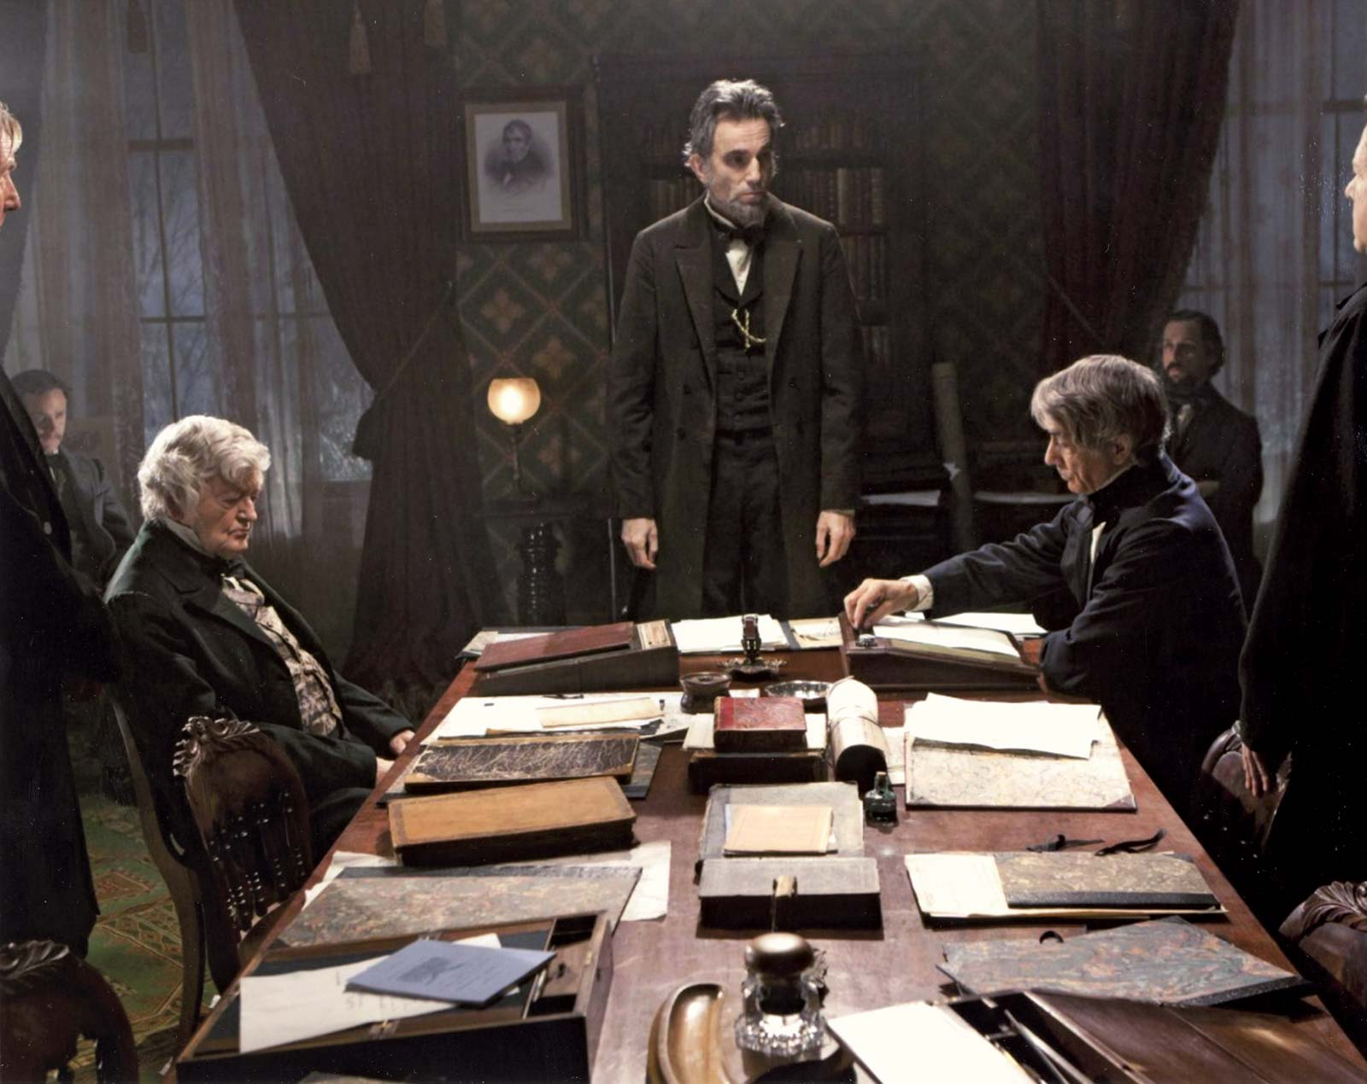
Lincoln
Political Capital (Above/Below)
Frame the Issue for the Audience
Timing
Go Rogue (if possible)
Eliminate External Gatekeeping (HR, Multiple Stakeholders)

Slide 19
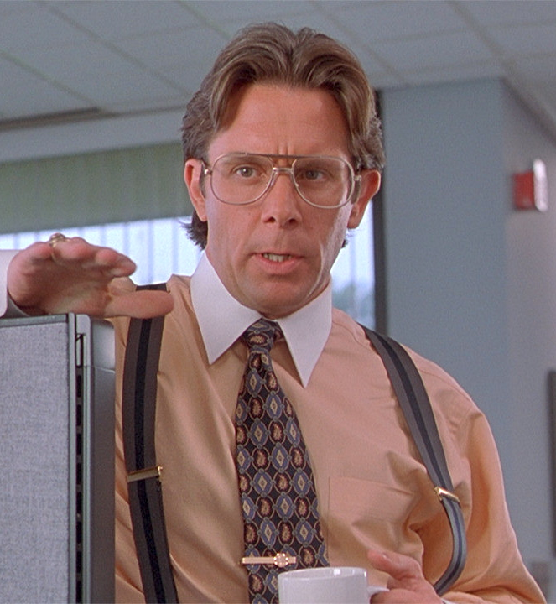
Office Space
Develop Processes that Empower Teams
Customized Processes Per Team
Automate Where Possible
Eliminate Gatekeeping

Slide 20
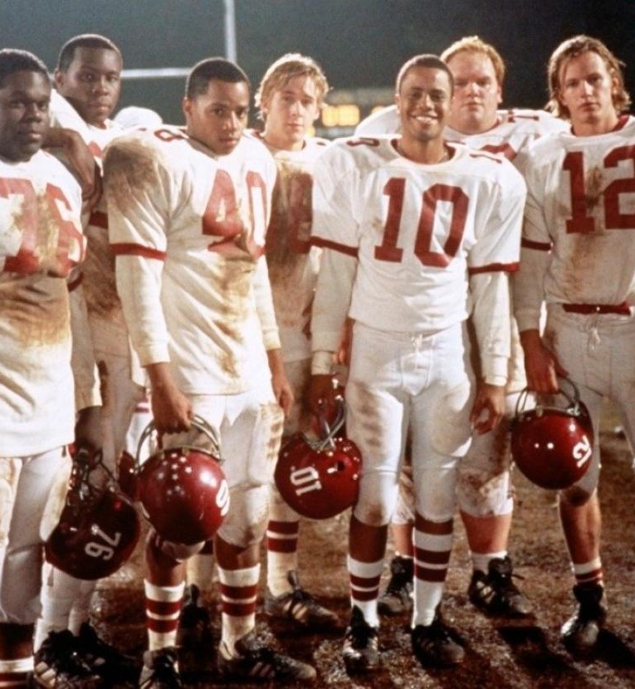
Remember the Titans
Psychological Safety
Promote Empathy
Life-Work Balance
Trust
Embrace Diversity
Define Values
Make Learning a Priority
Practice Blamelessness
"If I am a senior leader and my team doesn't feel comfortable sharing risks then I will never truly know reality“
- Nicole Forsgren
Notes:
Leading identifier in high performing organizations is Psychological Safety
"If I am a senior leader and my team doesn't feel comfortable sharing risks then I will never truly know reality" - Nicole Forsgren

Slide 21

Love Actually
Build a Culture of Empathy
Enables Compassion and Understanding
Allows People to Embrace Our Differences
Practice Active Listening
Avoid Making Assumptions
Build Positive Personal Relationships
Notes:
Listen for understanding, not to reply.
Engage with your coworkers beyond work.

Slide 22

The NeverEnding Story
Make Small Incremental Changes
Find a Pain Point, Fix It, and Move to the Next
Continue to Learn and Grow

Slide 23
Napoleon “Ike” Jones
Website: https://ikethe.dev/
Twitter: @ikethedev
LinkedIn: https://www.linkedin.com/in/napoleon-jones-1469a157/
Email: napoleon.i.jones.3@gmail.com

